Slide 1


micro:bit robot entry tutorial
Lesson 7
micro:bit advanced lesson 7 “Horse race lamp”
YahBoom micro:bit video tutorial

Slide 2
micro:bit robot entry tutorial
Content
Part1
Part 2
Part3
Part 4
Learning goals
Preparation
Search for blocks
Combine blocks
YahBoom micro:bit video tutorial

Slide 3
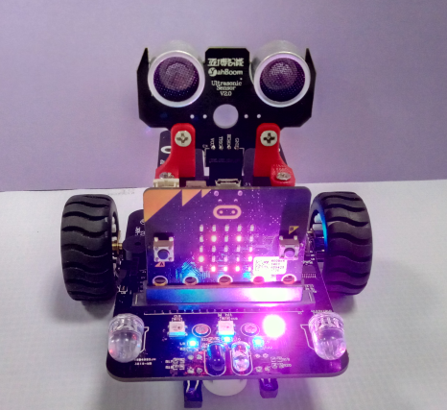
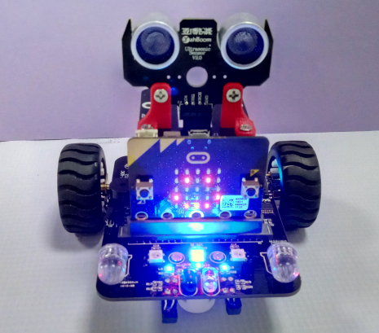
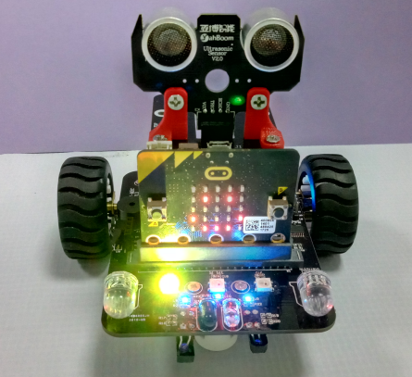
micro:bit robot entry tutorial
Part 1
Learning goals
After you download the program, you can see a smile on the dot matrix of the car, and the colorful lights are lit from left to right. Is it beautiful, isn't it? Let's take a look at the effect.
YahBoom micro:bit video tutorial

Slide 4
micro:bit robot entry tutorial
Part 2
Hardware:
● 1 X USB cable
● 1 X micro:bit robot
Preparation
Then the micro:bit is connected to the computer through USB, and the computer will pop up a U disk and click the URL in the U disk to enter the programming interface. Input this URL https://github.com/lzty634158/yahboom_mbit_en to get the package.
YahBoom micro:bit video tutorial

Slide 5
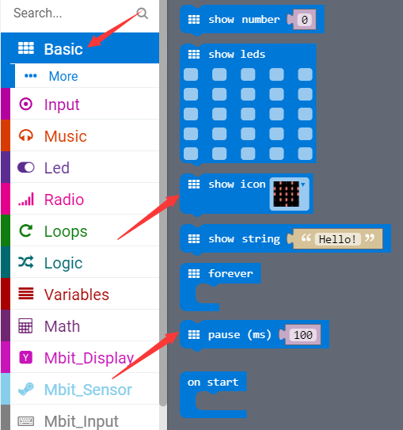
micro:bit robot entry tutorial
Part 3
Search for blocks
YahBoom micro:bit video tutorial

Slide 6
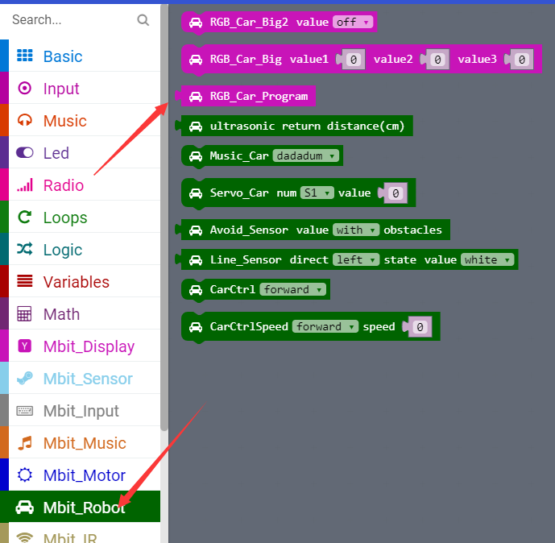
micro:bit robot entry tutorial
Part 3
Search for blocks
YahBoom micro:bit video tutorial

Slide 7
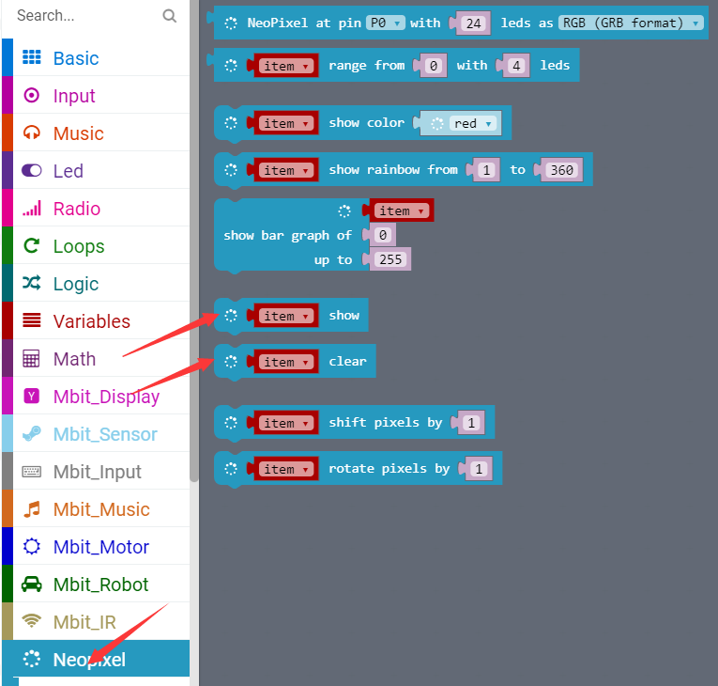
micro:bit robot entry tutorial
Part 3
Search for blocks
YahBoom micro:bit video tutorial

Slide 8
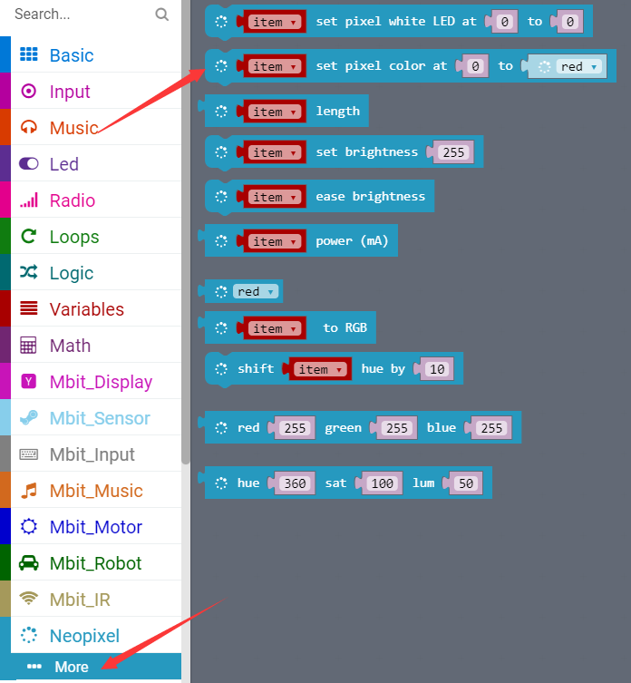
micro:bit robot entry tutorial
Part 3
Search for blocks
YahBoom micro:bit video tutorial

Slide 9
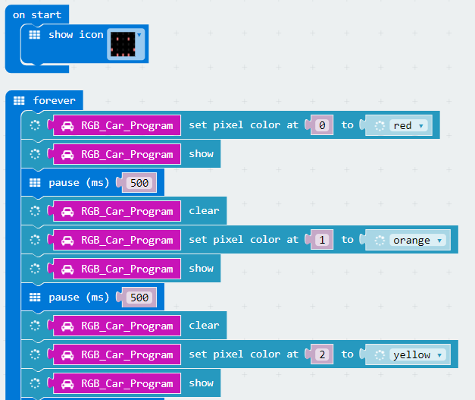
micro:bit robot entry tutorial
Part 4
The courses about water lamp need to turn off the power before downloading the new program, otherwise the water lantern will always be on.
Combine blocks
YahBoom micro:bit video tutorial

Slide 10
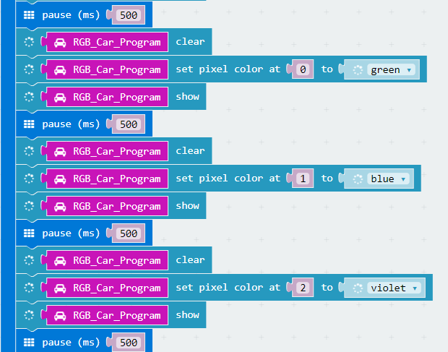
micro:bit robot entry tutorial
Part 4
Combine blocks
YahBoom micro:bit video tutorial

Slide 11
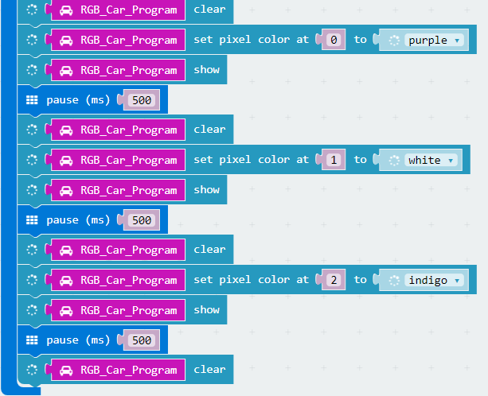
micro:bit robot entry tutorial
Part 4
Combine blocks
YahBoom micro:bit video tutorial

Slide 12
micro:bit robot entry tutorial
robot
lesson
Thanks for watching！
Powered by YahBoom
YahBoom micro:bit video tutorial

